Slide 1
EDA Case Study Analysis

Slide 2
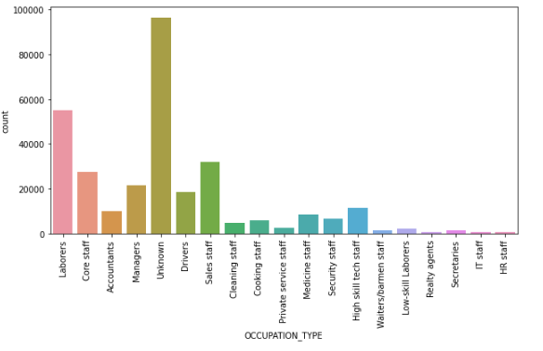
IMPUTE NULL VALUES IN OCCUPATION_TYPE

Slide 3
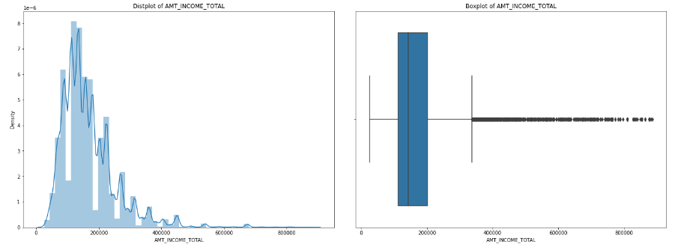
Analysis of AMT_INCOME_TOTAL column
Observations
Looking at the data, we can see that Income above 900K (99.9% value) are outliers
Both distplots and boxplots clearly show the same trend

Slide 4
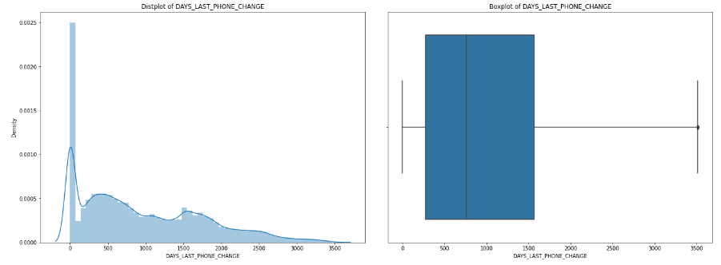
Analysis of DAYS_LAST_PHONE_CHANGE column
Observations
As observed from displot and boxplot, the outliers tend to exist after 3514.0 (Outlier value is derived using
Max_value using IQR formulae)

Slide 5
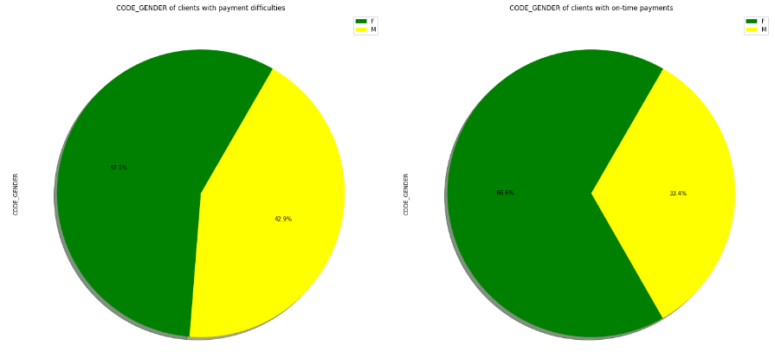
Analysis of CODE_GENDER
Observations
Looking at CountPlot and PieChart, there is a 9.5% decrease in "Male" values from CODE_GENDER b/w clients
with payment difficulties to on-time payments.
It's a weak correlation that Males have more payment difficulties.

Slide 6
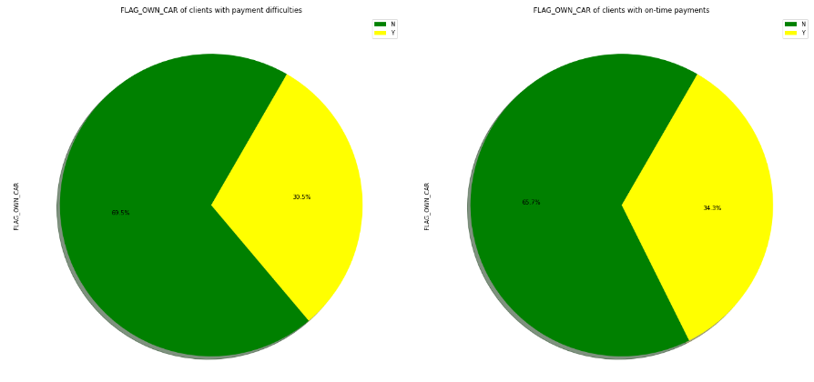
Analysis of FLAG_OWN_CAR
Observations
Looking at CountPlot, we don't see significant differences in FLAG_OWN_CAR b/w clients with payment difficulties and on-time payments
Looking at PieChart, we don't see significant differences in FLAG_OWN_CAR b/w clients with payment difficulties and on-time payments.

Slide 7
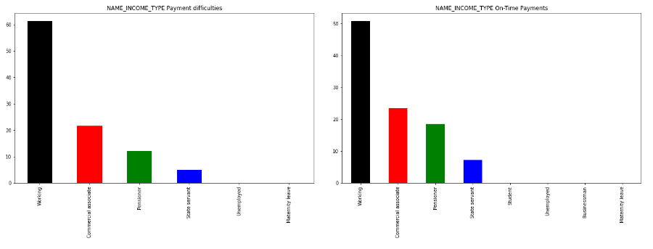
Analysis of NAME_INCOME_TYPE
Observations
Pensioners have better on-time payments
Students don't have Payment difficulties
Businessmen don't have Payment difficulties

Slide 8
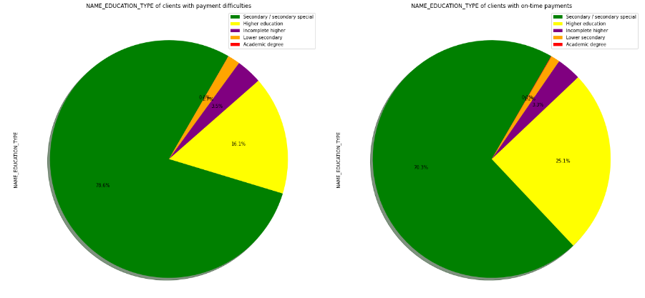
Analysis of NAME_FAMILY_STATUS
Observations
Clients who are 'Married' are 59.8% with payment difficulties and 64.2% with on-timepayments
Clients who are 'Widow' are 3.8% with payment difficulties and 5.4% with on-timepayments
Clients who are 'Single/not married' are 18.0% with payment difficulties and 14.5% with on-timepayments
Remaining categories don't provide any conclusive results

Slide 9
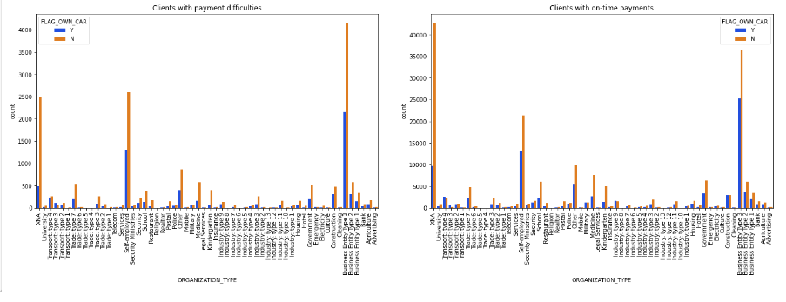
Analysis of ORGANIZATION_TYPE V/S FLAG_OWN_CAR
Observations
Clients who are Self-employedand don't own Car have more Payment difficulties compared to On-Time Payments

Slide 10
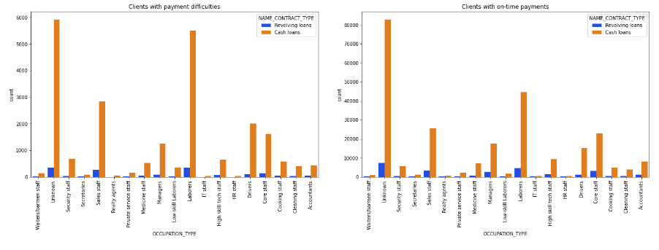
Analysis of OCCUPATION_TYPE V/S NAME_CONTRACT_TYPE
Observations
Clients who are Sales staff,Laborers,Drivers and have Cash loans have more Payment difficulties compared to On-Time Payments

Slide 11
Categorical V/S Categorical variables

Slide 12
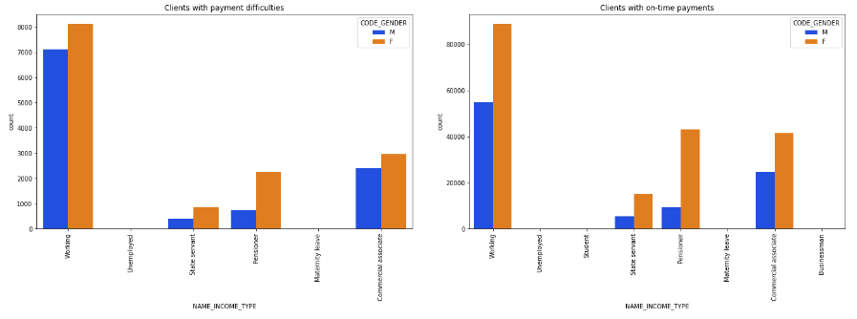
Analysis of NAME_INCOME_TYPE V/S CODE_GENDER
Observations
Clients who are Working and Male have more Payment difficulties compared to On-Time Payments
Clients who are Pensioner and Female have more Payment difficulties compared to On-Time Payments
Clients who are Businessman and Students do their payments On-Time though their record count is low

Slide 13
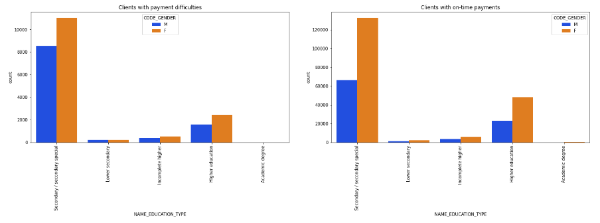
Analysis of NAME_EDUCATION_TYPE V/S CODE_GENDER
Observations
Clients who have Secondary/Secondary special education and Male have more Payment difficulties compared to On-Time Payments
Clients who have Higher education and Female have more On-Time Payments compared to Payment difficulties

Slide 14
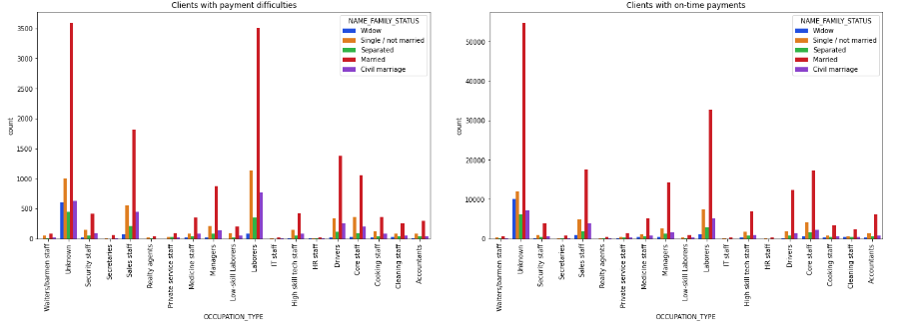
Analysis of NAME_FAMILY_STATUS V/S OCCUPATION_TYPE
Observations
Clients who are Single/not married, Married & Civil marriage and are Waiters/barmen staff have more Payment difficulties compared to On-Time Payments
Clients who are Single/not married & Married and are Laborers have more Payment difficulties compared to On-Time Payments
Clients who are Married and are Drivers have more Payment difficulties compared to On-Time Payments
Married and Accountants have better On-Time Payments

Slide 15
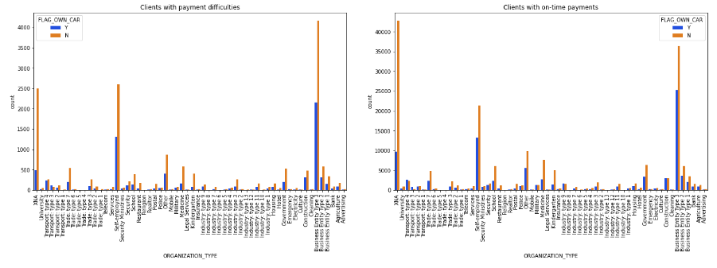
Analysis of ORGANIZATION_TYPE V/S FLAG_OWN_CAR
Observations
Clients who are Self-employedand don't own Car have more Payment difficulties compared to On-Time Payments

Slide 16
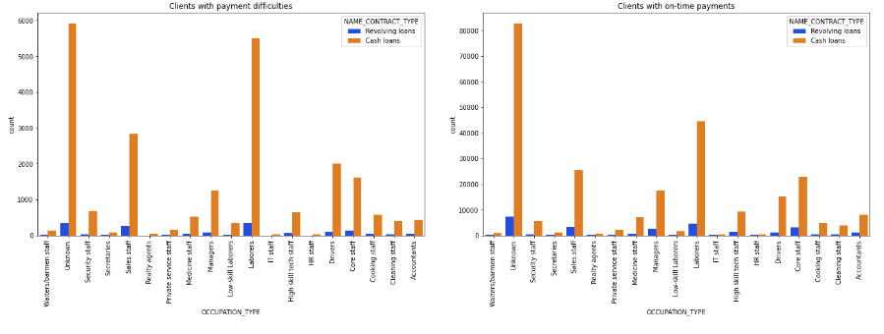
Analysis of OCCUPATION_TYPE V/S NAME_CONTRACT_TYPE
Observations
Clients who are Sales staff,Laborers,Drivers and have Cash loans have more Payment difficulties compared to On-Time Payments

Slide 17
FOR
Previous Application Data
ANALYSIS

Slide 18
Checking columns
with
NULL values < 40%

Slide 19
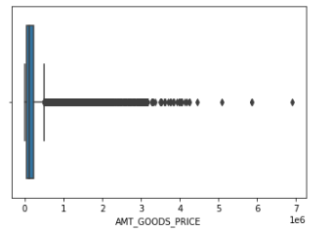
Analysis of AMT_GOODS_PRICE column
Observations
Looking at the boxplot, median is 112320.00
Most recurring value is 45000.0
Mean value is 227847.27928334344
Since missing percentage value is higher (23.08%), it would be better to leave the data as it is and not perform imputations

Slide 20
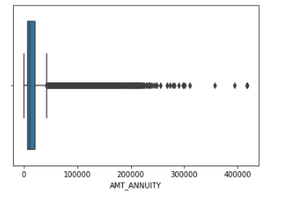
Analysis of AMT_ANNUITY column
Observations
Looking at the boxplot, median is 11250.00
Most recurring value is 2250.0
Mean value is 15955.120659450406
Since missing percentage value is higher (22.29%), it would be better to leave the data as it is and not perform imputations

Slide 21
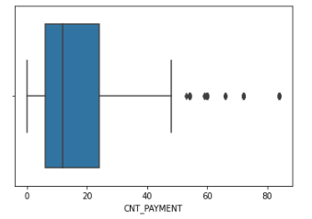
Analysis of CNT_PAYMENT column
Observations
Looking at the boxplot, median is 12.00
Most recurring value is 12.0
Mean value is 16.0540815603274
Though median & mode are same, since missing percentage value is higher (22.29%), it would be better to leave the data as it is and not perform imputations

Slide 22
Dealing with outliers
for numerical columns

Slide 23
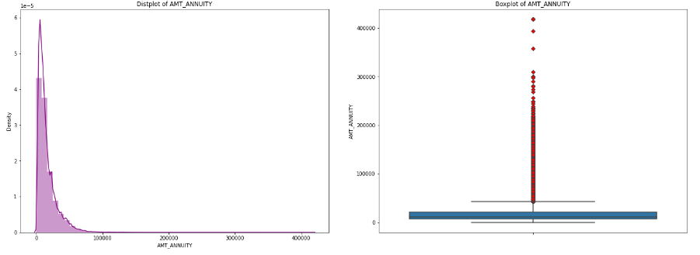
Analysis of AMT_ANNUITY column
Observations
AMT_ANNUITY values above 42163.38 are outliers

Slide 24
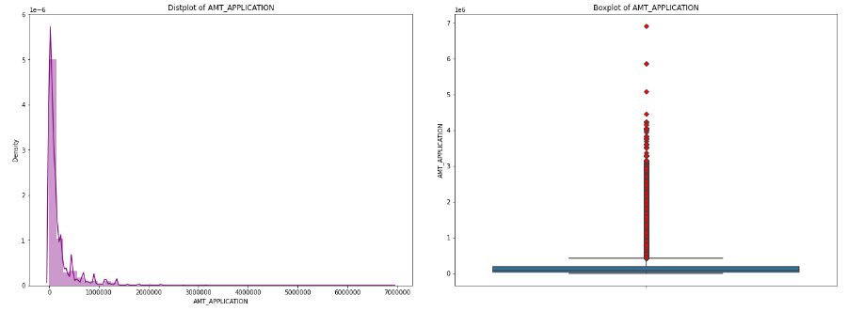
Analysis of AMT_APPLICATION column
Observations
AMT_APPLICATION values above 422820.0 are outliers

Slide 25
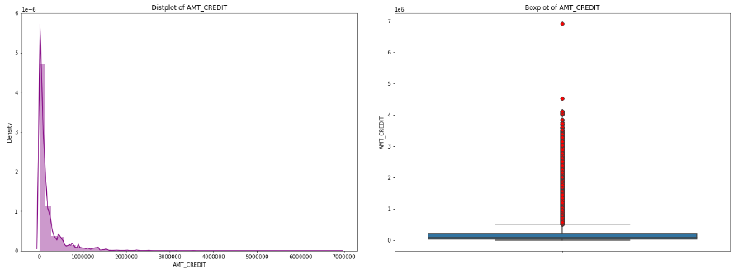
Analysis of AMT_CREDIT column
Observations
AMT_CREDIT values above 504805.5 are outliers

Slide 26
Univariate analysis
of categorical variables

Slide 27
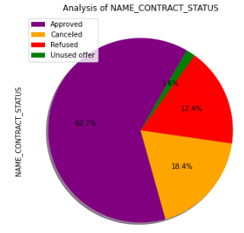
Analysis of NAME_CONTRACT_STATUS
Observations
Approved loan status is the highest among all loan applications
Canceled loan status is the second highest among all loan applications

Slide 28
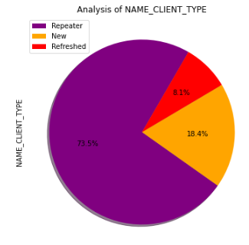
Analysis of NAME_CLIENT_TYPE
Observations
Repeater client type is the highest among all loan applications
New client type is the second highest among all loan applications

Slide 29
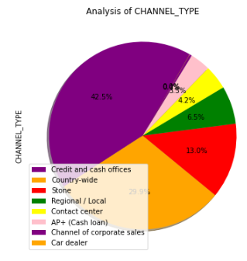
Analysis of CHANNEL_TYPE
Observations
Country-wide Channel type is the highest among all loan applications
Credit and cash offices is the second highest Channel Type among all loan applications

Slide 30
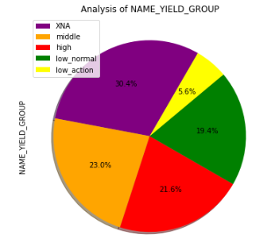
Analysis of NAME_YIELD_GROUP
Observations
XNA interest rate is the highest among all loan applications
middle and high interest rates are the second and third highest among all loan applications

Slide 31
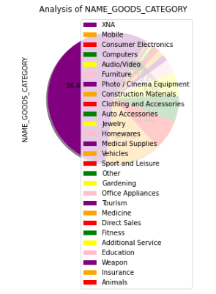
Analysis of NAME_GOODS_CATEGORY
Observations
XNA goods category is the highest among all loan applications
mobile goods categoryis the second highest among all loan applications

Slide 32
Univariate analysis
of numerical variables

Slide 33
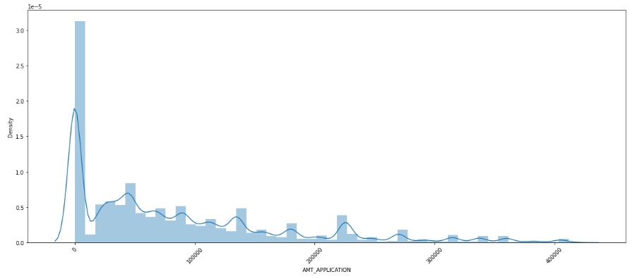
Analysis of AMT_APPLICATION
Observations
Most of the loan amount applied by the clients initially seems to be very small as can be seen from the huge spike at the beginning of the distribution

Slide 34
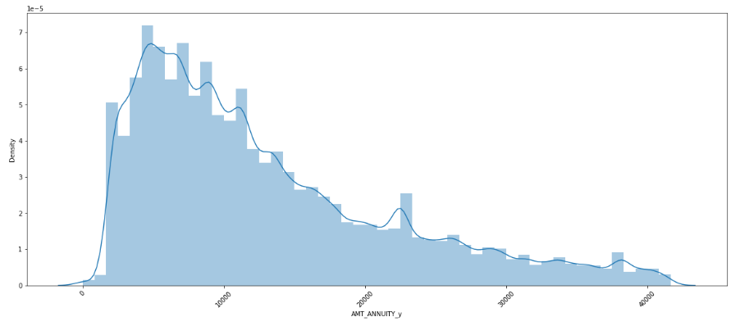
Analysis of AMT_ANNUITY_y
Observations
Most of the previous loan's annuity from the clients is less than 10,000 as the distribution is high here
As previous loan's annuity increases, the no. of clients decreases

Slide 35
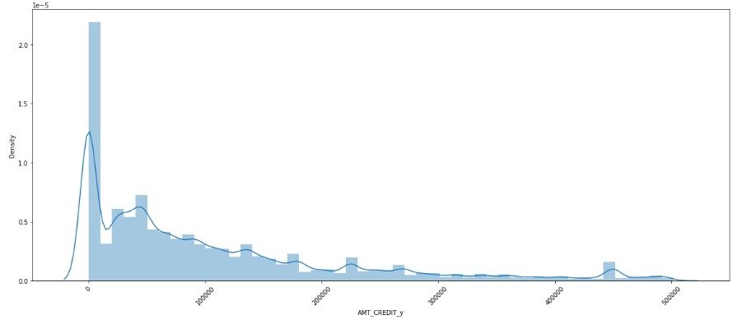
Analysis of AMT_CREDIT_y
Observations
This distribution very closely resembles that of AMT_APPLICATION. This means that most people received the loan amount that they applied for

Slide 36
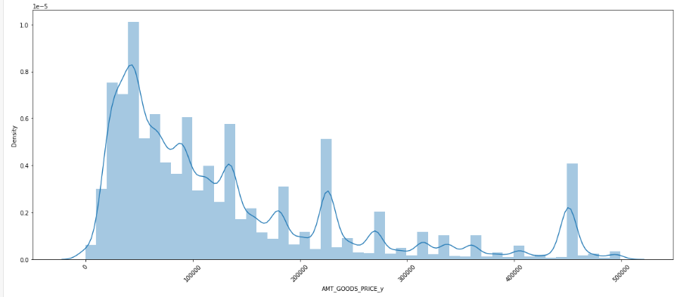
Analysis of AMT_GOODS_PRICE_y
Observations
Most of the goods price asked by clients in previous application is less than 100K

Slide 37
Correlation analysis
of numerical variables

Slide 38
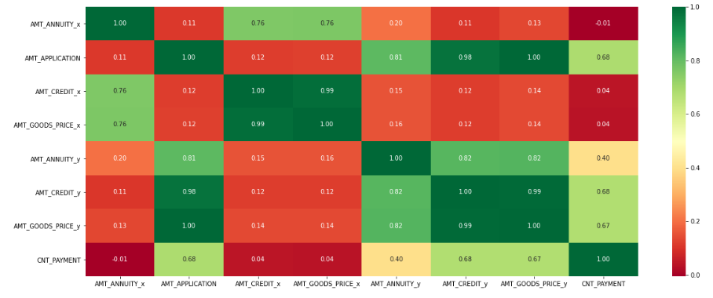
Plotting correlation matrix
Observations
AMT_APPLICATION has a high correlation with AMT_ANNUITY_y,AMT_CREDIT_y,AMT_GOODS_PRICE_y and decent correlation with CNT_PAYMENT
AMT_GOODS_PRICE_y has a high correlation with AMT_ANNUITY_y,AMT_CREDIT_y,AMT_APPLICATION and decent correlation with CNT_PAYMENT
AMT_CREDIT_y has a high correlation with AMT_GOODS_PRICE_y and decent correlation with CNT_PAYMENT
AMT_ANNUITY_x has a high correlation with AMT_GOODS_PRICE_y,AMT_CREDIT_y
AMT_ANNUITY_x has a high correlation with AMT_GOODS_PRICE_x,AMT_CREDIT_x
AMT_CREDIT_x has a high correlation with AMT_GOODS_PRICE_x

Slide 39
Bivariate/Multivariate analysis
Continuous V/S Continuous variables

Slide 40
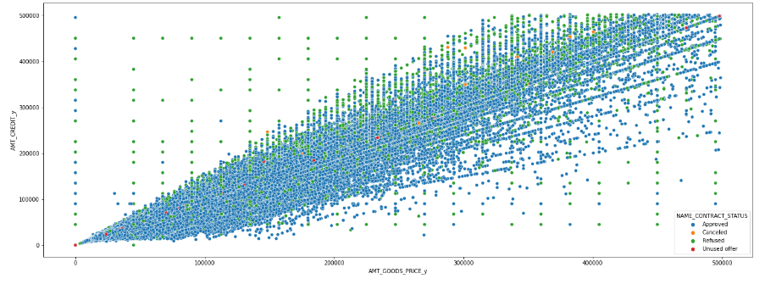
Analysis of AMT_GOODS_PRICE_y V/S AMT_CREDIT_y V/S NAME_CONTRACT_STATUS
Observations
At lower levels of previous application's Goods price < 200K and Credit > 300k, have a chance of getting refused. However, this is a weak correlation as we have less data points to support this

Slide 41
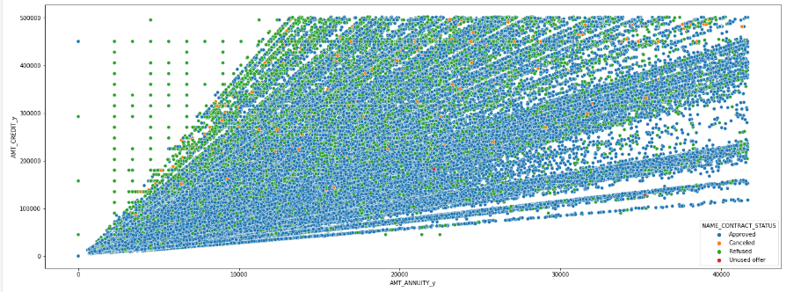
Analysis of AMT_ANNUITY_y V/S AMT_CREDIT_y V/S NAME_CONTRACT_STATUS
Observations
There are lots of refusal observations with Annuity amount < 10000 and Credit amount > ~250K. This might be because higher credit amount should also require higher Annuity from Client to pay it

Slide 42
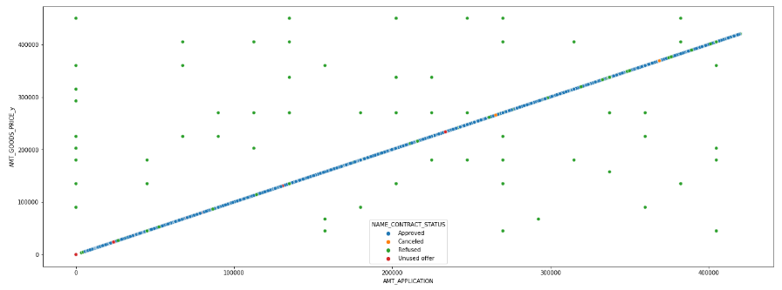
Analysis of AMT_APPLICATION V/S AMT_GOODS_PRICE_y V/S NAME_CONTRACT_STATUS
Observations
Application amount has strong positive correlation with Goods price

Slide 43
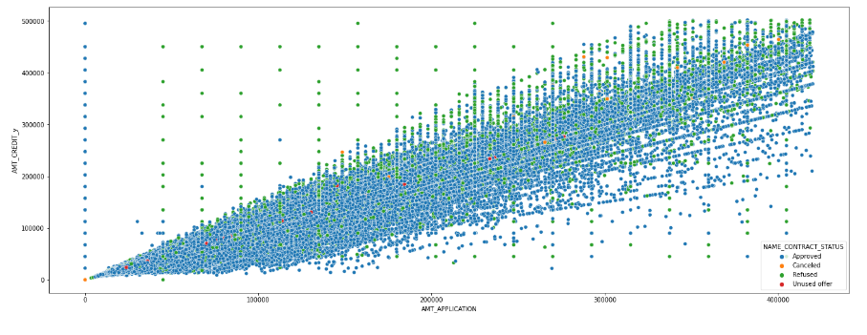
Analysis of AMT_APPLICATION V/S AMT_CREDIT_y V/S NAME_CONTRACT_STATUS
Observations
Application amount has strong positive correlation with Credit amount

Slide 44
Continuous V/S Categorical variables

Slide 45
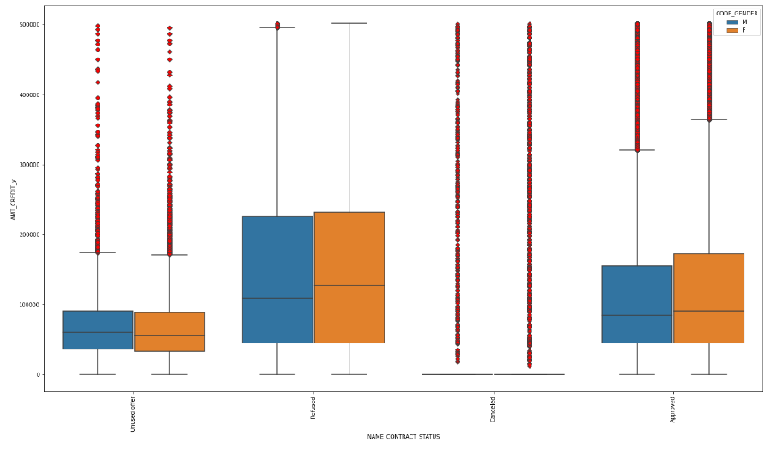
Analysis of NAME_CONTRACT_STATUS V/S AMT_CREDIT_y V/S CODE_GENDER
Observations
Clients who are Refused and Female apply for higher median credit amount than Male

Slide 46
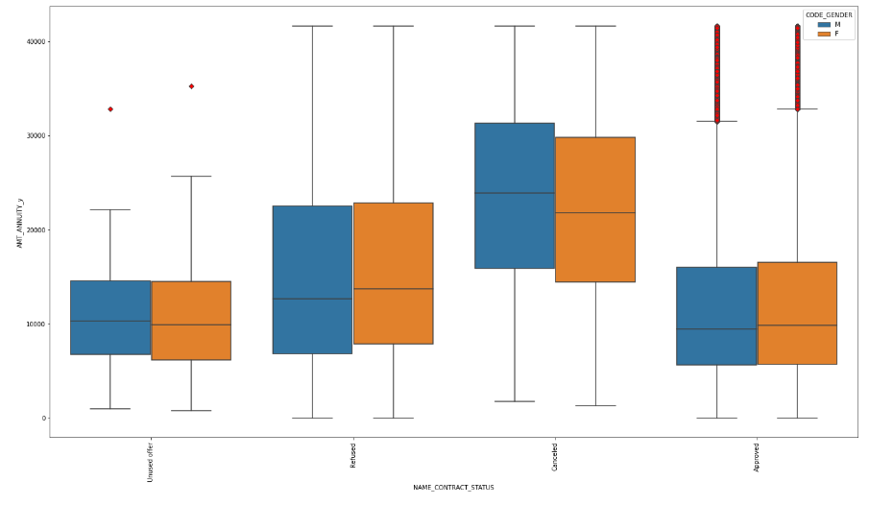
Analysis of NAME_CONTRACT_STATUS V/S AMT_ANNUITY_y V/S CODE_GENDER
Observations
Clients who got Cancelled and Male paid higher median Annuity than Female
Clients who got Refused and Female paid higher median Annuity than Male

Slide 47
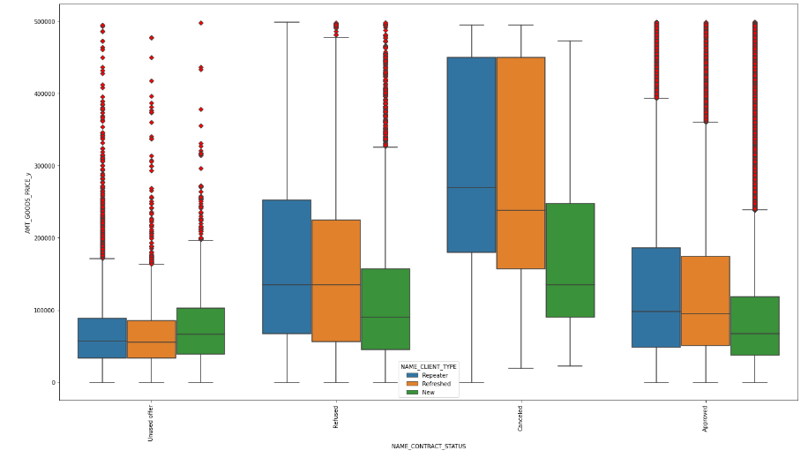
Analysis of NAME_CLIENT_TYPE V/S AMT_GOODS_PRICE_y V/S NAME_CONTRACT_STATUS
Observations
Clients who are New and Canceledhave less median goods price compared to Repeater and Refreshed
Clients who are Approved and New have less median goods price compared to Repeater and Refreshed

Slide 48
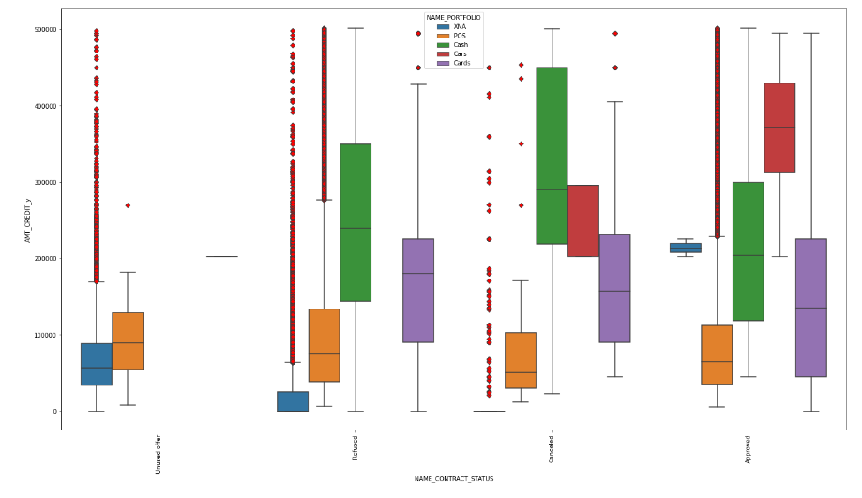
Analysis of NAME_CONTRACT_STATUS V/S AMT_CREDIT_y V/S NAME_PORTFOLIO
Observations
Clients who have Unused offer receive more median credit in POS portfolio
Clients who are Refused receive more median credit in Cash portfolio
Clients who are Approved receive more median credit in Cars portfolio

Slide 49
Categorical V/S Categorical variables

Slide 50
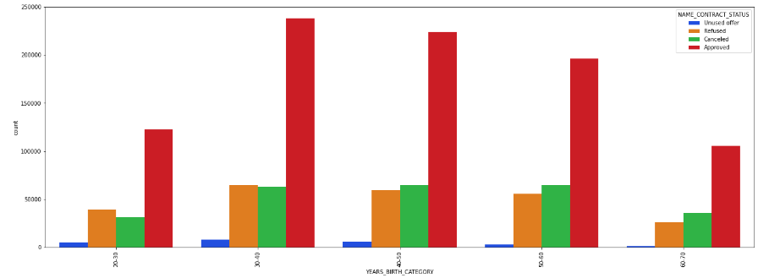
Analysis of YEARS_BIRTH_CATEGORY V/S NAME_CONTRACT_STATUS
Observations:- * Clients who are in the age range 30-40 get most approval followed by clients in 40-50 age range
* Clients who are in the age range 60-70 receive least refusals followed by 20-30 age range

Slide 51
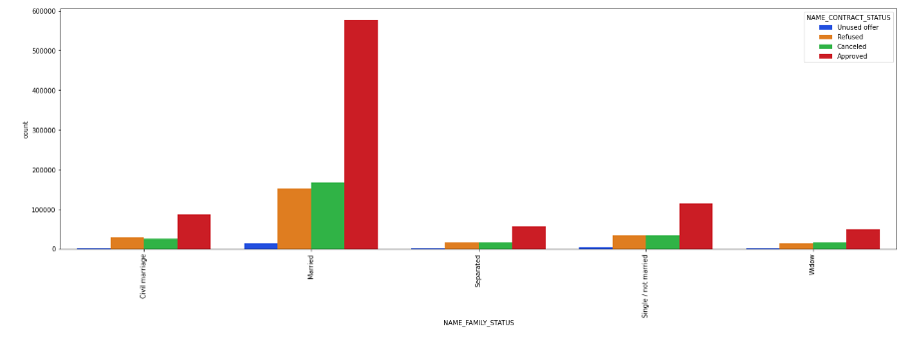
Analysis of NAME_FAMILY_STATUS V/S NAME_CONTRACT_STATUS
Observations:- Clients who are Married receive the most approvals

Slide 52
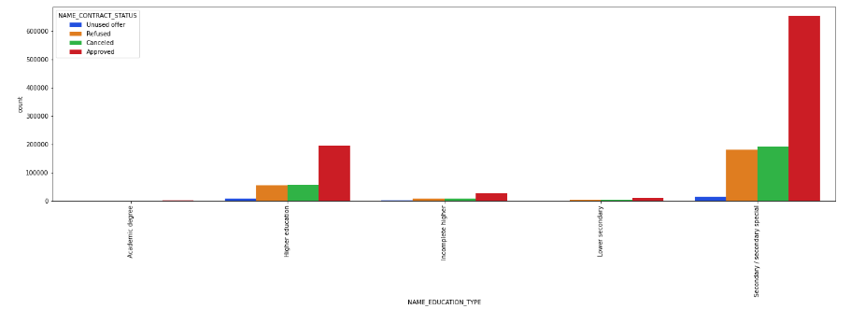
Analysis of NAME_EDUCATION_TYPE V/S NAME_CONTRACT_STATUS
Observations:- Clients who have Secondary/secondary special receive the most approvals

Slide 53
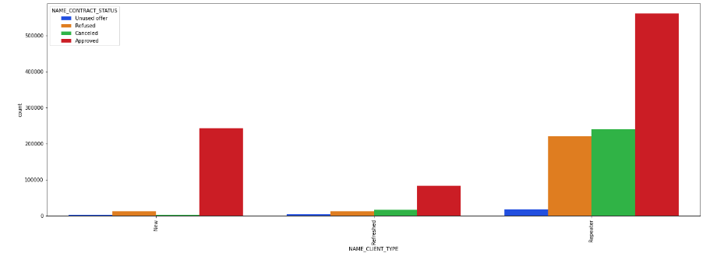
ANALYSIS OF NAME_CLIENT_TYPE V/S NAME_CONTRACT_STATUS
Observations:- Clients who are Repeaters receive the most approvals followed by New

Slide 54
Conclusion: Client categories to be targeted for providing loan
Clients who are employed for more than 19 years
Clients in the age range 30-40 and 40-50
Clients who are Married
Male clients with Academic degree
Students and Businessman
Repeater clients

Slide 55
THE END

